Slide 1


MS Excel

Slide 2
Contents
Introduction
Interface & Tools 3. Formatting
Formula & Calculations
SUM, AVERAGE, MAX, MIN 4.2 Percentage formula
4.3 IF Condition
Sorting
Filter
Charts

Slide 3
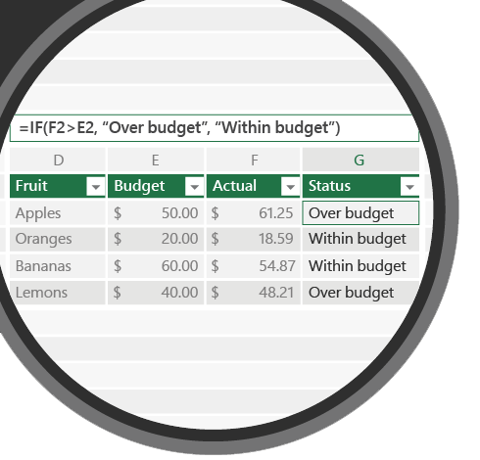
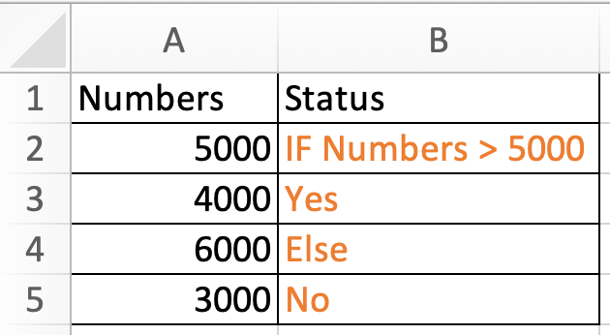
4.3.1
IF
IF condition

Slide 4
4.3.1 Question
Q1. Correct IF condition to find row 1 status?
a. =IF(Numbers>5000,"Yes","No")
b. =IF(B2>5000,Yes,No)
c. =IF(A2>5000,"Yes","No")

Slide 5
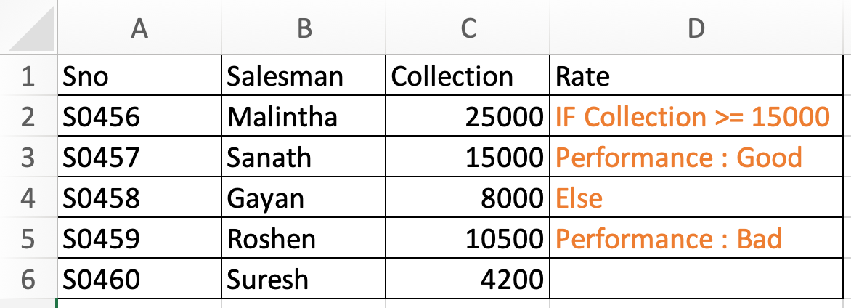
4.3.2
IF
IF condition

Slide 6
4.3.2 Question
Q1. Select the correct IF condition to find Rate?
a. =IF(C2>=Collection,"Good","Bad")
b. =IF(C2>=15000,"Good","Bad")
c. =IF(Collection >=15000,Good,Bad)

Slide 7
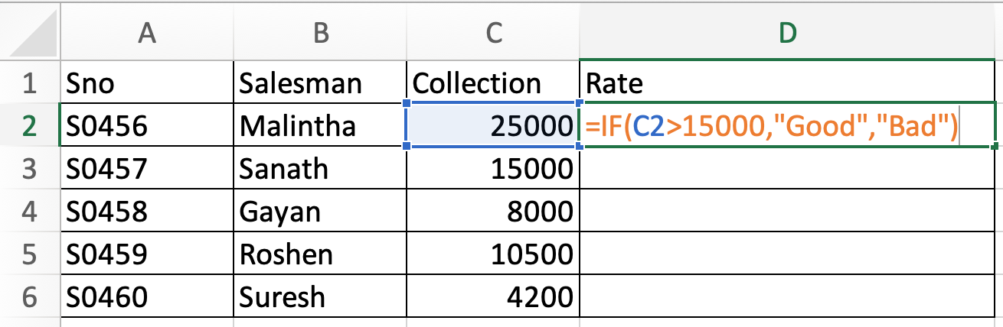
4.3.2 Question
Q2. What will be the rate for Sanath?
Good
Bad
Hint : Check the condition properly > OR >=

Slide 8
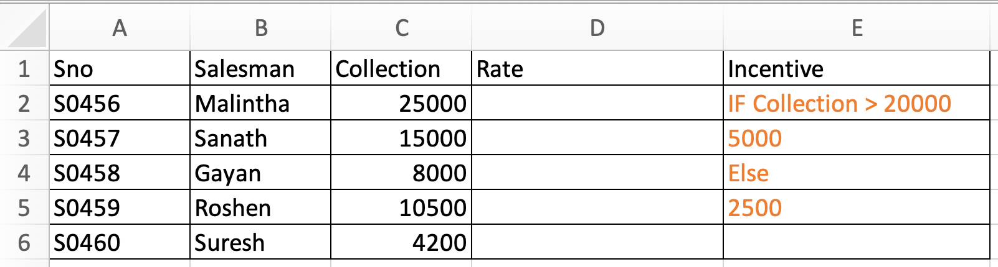
4.3.2 Question
Q3. Correct formula to find incentive?
a. =IF(C2>=20000,5000,2500)
b. =IF(C2>=20000,”5000”,”2500”)
c. =IF(Collection>=20000,5000,2500)
Hint : Check answer whether its TEXT or NUMBER

Slide 9
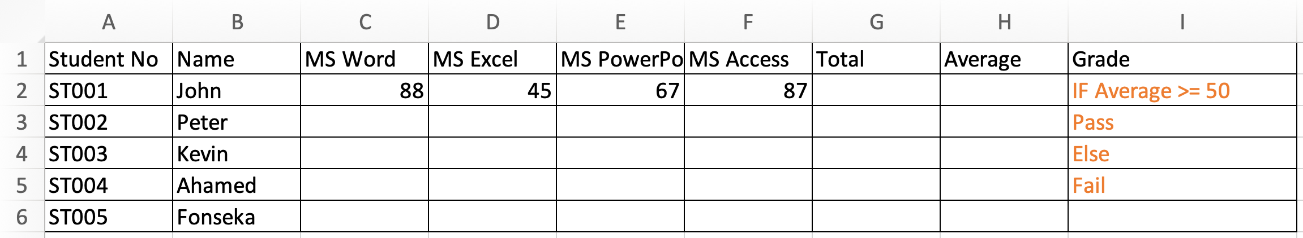
4.3.3 Question
Q1. Which one is correct formula to find grade?
a. =IF(H2>=50,"Pass","Fail")
b. =IF(G2>=50,"Pass","Fail")
c. =IF(H2>=50, Pass,Fail)

Slide 10
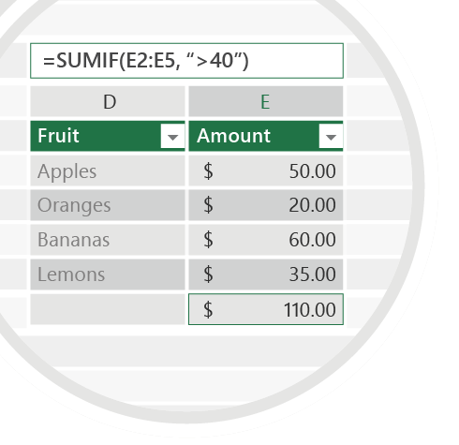



Exercise 4.3
Check your email for Question 4.3.1.pdf Question 4.3.2.pdf Question 4.3.3.pdf
Fill all the blanks with correct formula and mail us your work for below mentioned email id
Emails
TO : shalomshan089@gmail.com

